Slide 1

E-commerce Sales Prediction
Team:
Sanket Sharad Baviskar
Supraja Mohanagandhi
Sahir Hussain Syed

Slide 2
Problem Statement
To develop machine learning models for predicting sales in an e-commerce platform
Analyse the trends on the weekly sales on different months, rolling average
Understand the effect of different parameters on the sales
Identify the best model to predict the sales
Plot the predicted values on the graph and compare the performance of the models used

Slide 3

Code Walkthrough

Slide 4
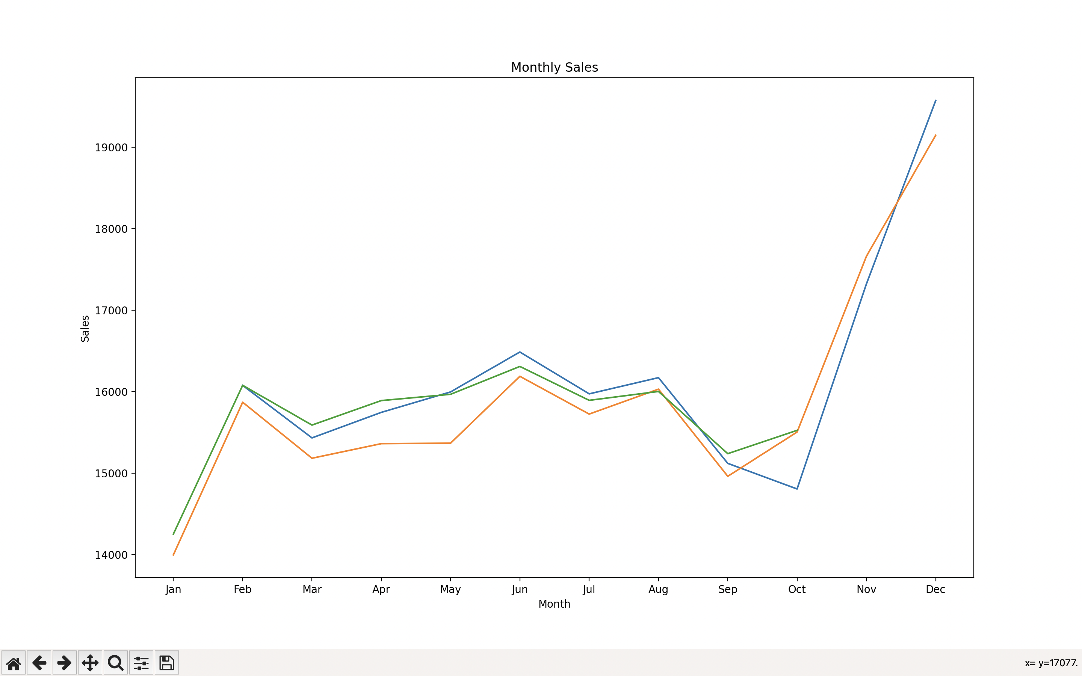
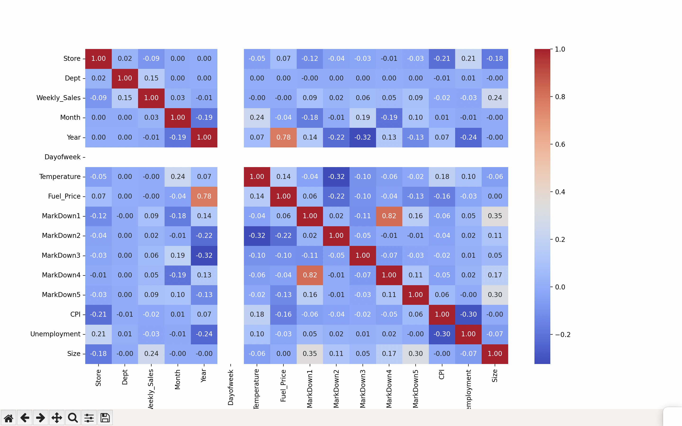
Exploratory Data Analysis

Slide 5
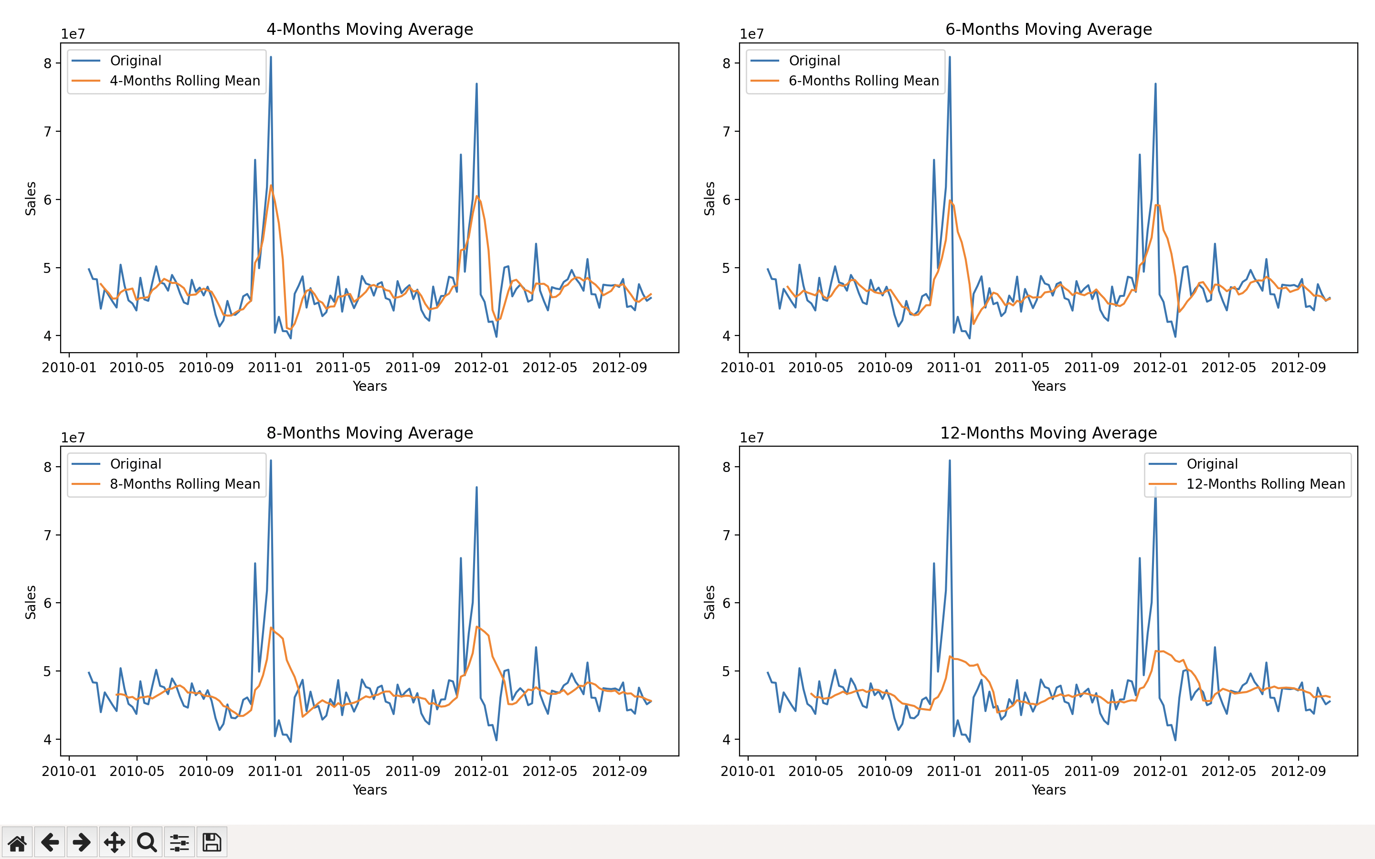
Rolling average sales

Slide 6
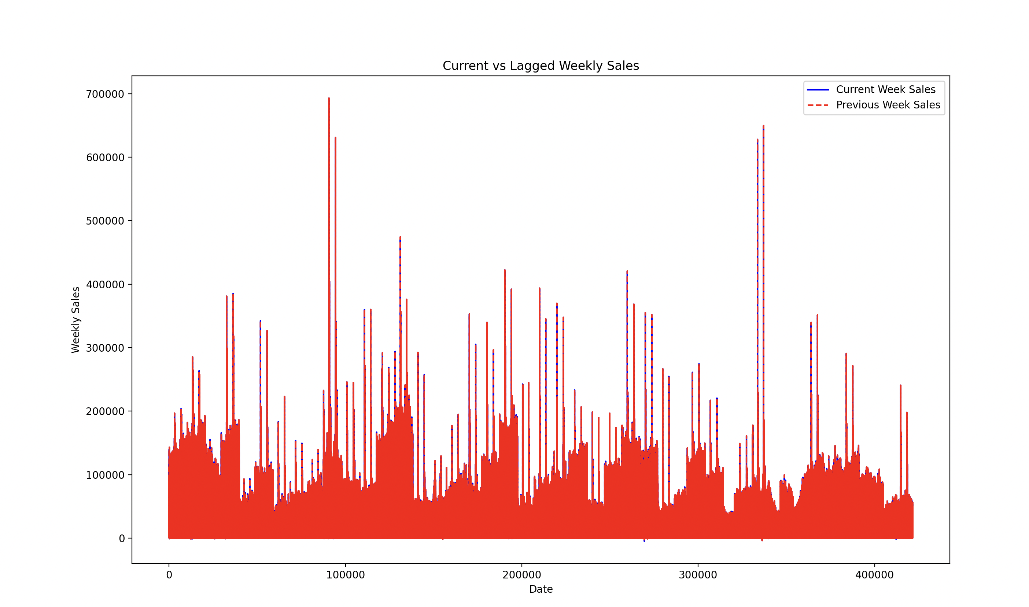
Feature Engineering
Lag features to capture the effect of past values on the target variable

Slide 7
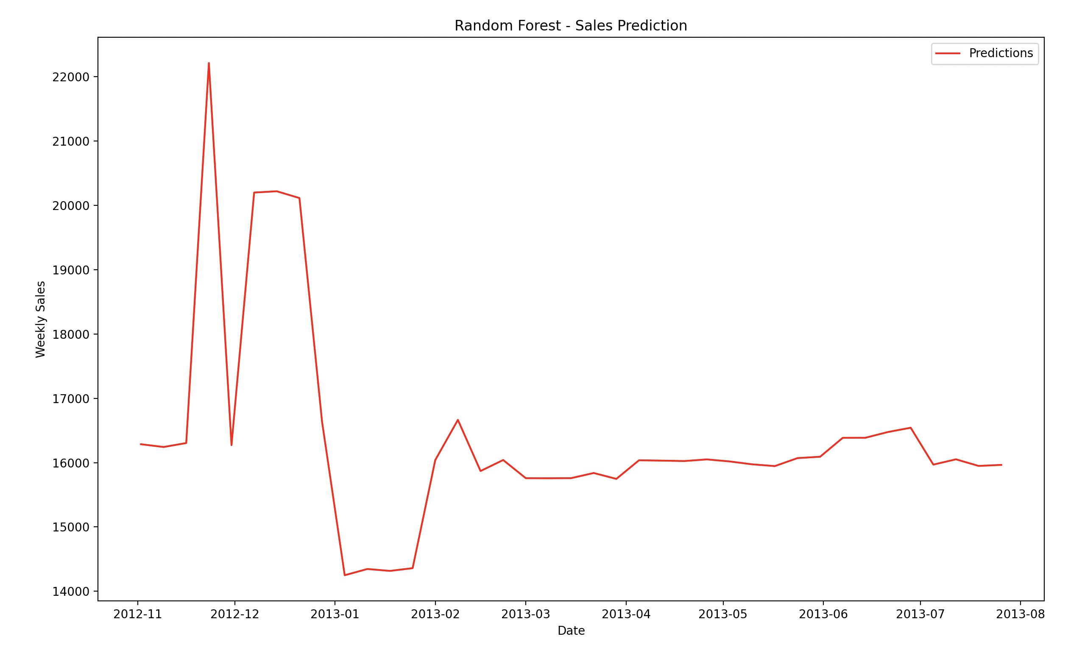
Random Forest
Random Forest is a classification and regression ensemble learning technique.
Using Randomness to Reduce Overfitting: Using feature subsets and data samples, randomness is integrated into tree construction.
Sturdy and adaptable: Random Forest is well-known for its robustness and adaptability when working with a wide range of data types.
Accuracy : 88.06131457776414%

Slide 8
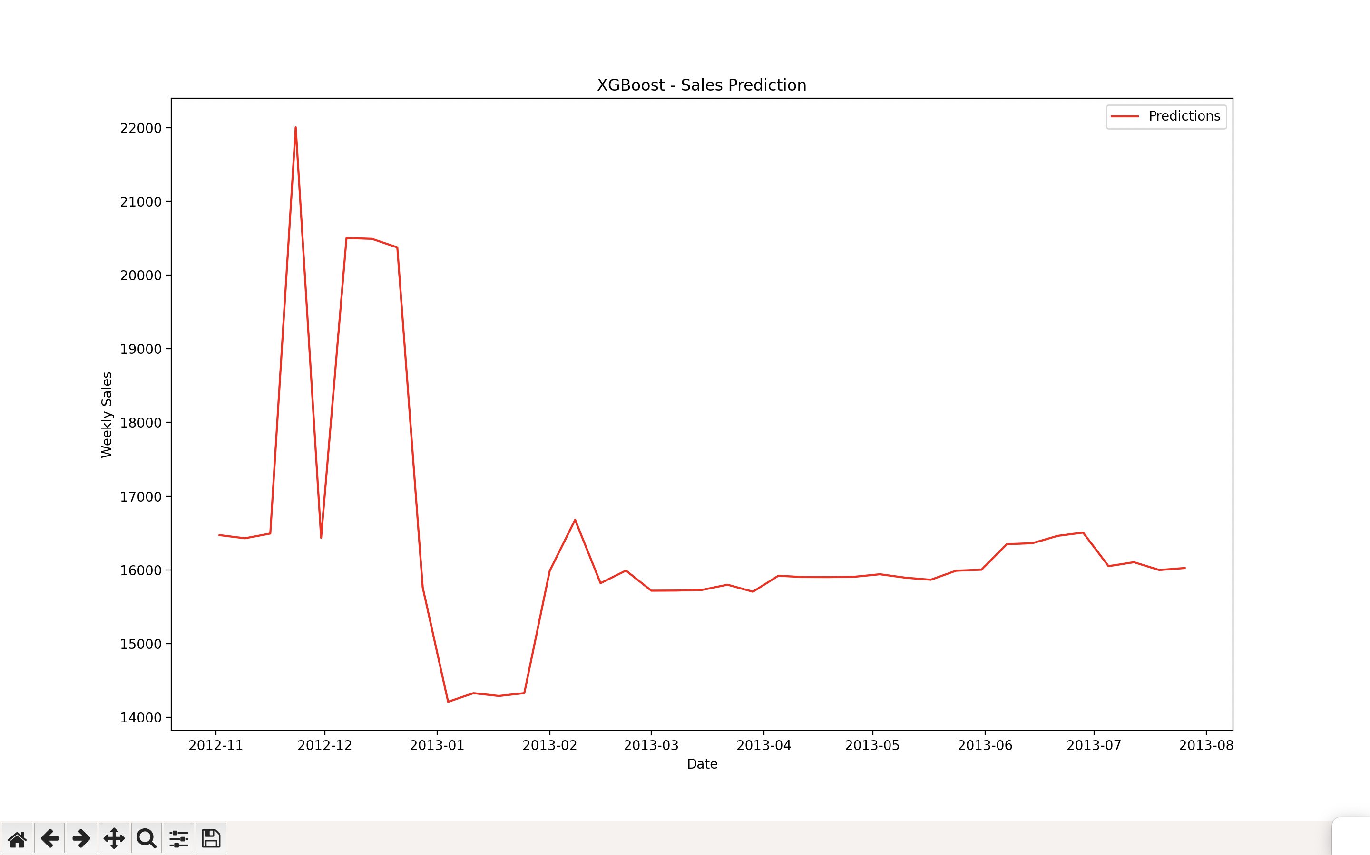
XGboost
Efficient Ensemble Learning: XGBoost, or Extreme Gradient Boosting, is a powerful machine learning algorithm that excels in regression and classification tasks.
Optimized Performance and Scalability: XGBoost employs gradient boosting, building trees sequentially to correct errors from previous iterations and focusing on challenging examples.
Accuracy : 75.75190958074224%

Slide 9
ARIMA
A time series forecasting model called ARIMA (AutoRegressive Integrated Moving Average)
This model combines moving average, differencing, and autoregression components. By using past data trends, it is possible to predict future values.
ARIMA is a good tool for estimating sales volumes because it may capture trends, seasonality, and cyclic patterns in sales prediction.
The adequacy of the model parameters and the underlying data patterns dictate the efficiency of the system.

Slide 10
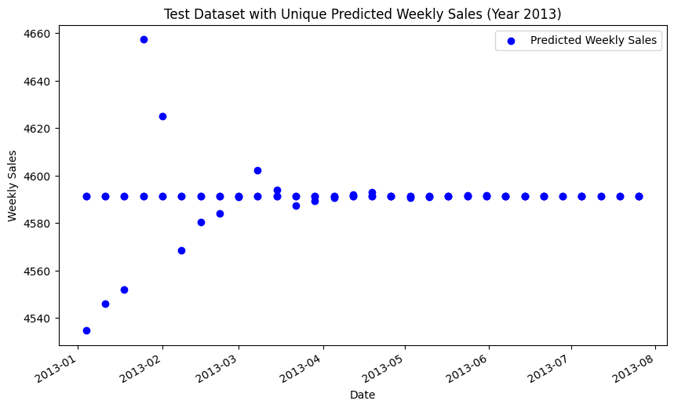
What could have been better?

Slide 11
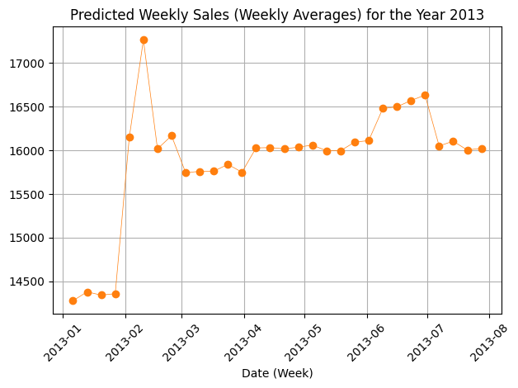
K Nearest Neighbors Regressor
K Nearest Neighbors (KNN) Regressor is a supervised machine learning algorithm used for regression tasks.
It predicts the continuous target variable by considering the average of the K-nearest neighbors' output values in the feature space.
it relies on the proximity of data points in the feature space to make predictions, making it intuitive and easy to understand.
Accuracy : 89.59%

Slide 12
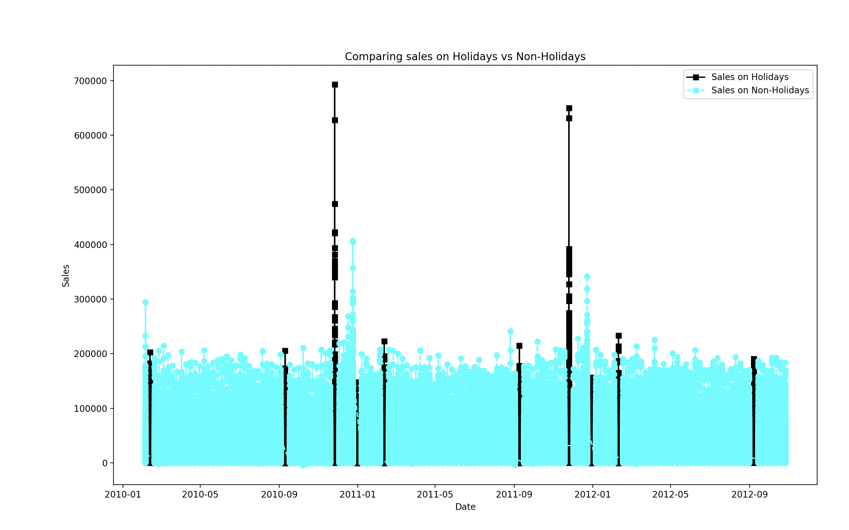
Holiday Impact Analysis
There is a significant boost in the sales on holidays compared to non-holiday weeks
This is a critical observation that can help e-commerce companies plan resources and manage inventory
With the power of applying marketing and promotional strategies on holidays, companies can take advantage of consumer spending

Slide 13
Potential buyers
Retailers can use predictive analytics to forecast demand for products, optimize inventory levels, and personalize marketing strategies for different customer segments.
Pharmaceutical companies may utilize sales predictions to forecast demand for medications, optimize distribution, and plan production schedules.
Telecommunication companies can benefit from sales predictions to forecast demand for new devices, plan network capacity, and optimize customer acquisition strategies.
Real estate developers and agencies can use predictive models to anticipate demand for properties, optimize pricing, and tailor marketing strategies to specific buyer profiles.

